Slide 1
Calculating the Potential from the Field

Slide 2
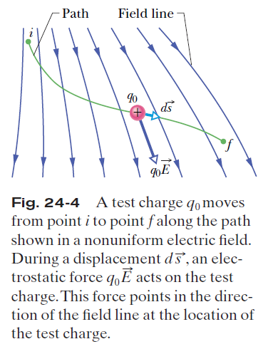
Calculating the Potential from the Field

Slide 3




Calculating the Potential from
the Field:
Total work:

Slide 4
Calculating the Potential from
the Field:
This is the potential V at any point f in the electric field relative to the zero potential at point i. If point i is at infinity, then this is the potential V at any point f relative to the zero potential at infinity.

Slide 5
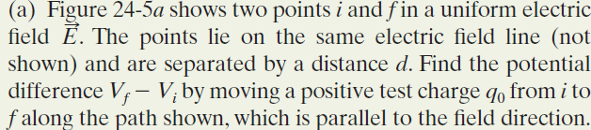
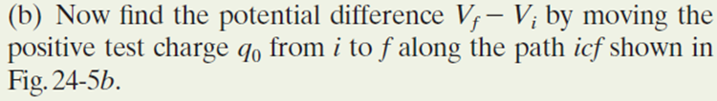
Example, Finding the Potential change
from the Electric Field:

Slide 6
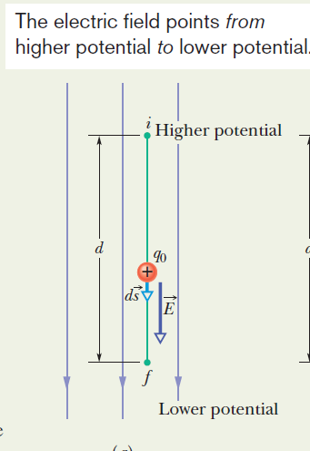

Slide 7
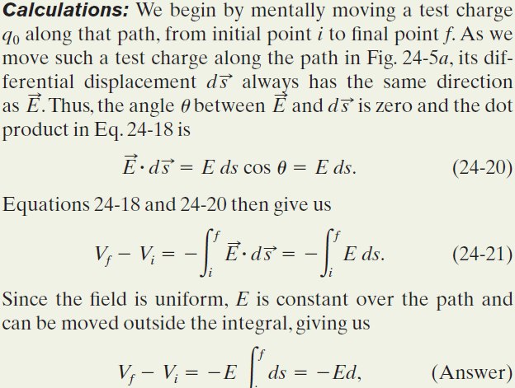

Slide 8

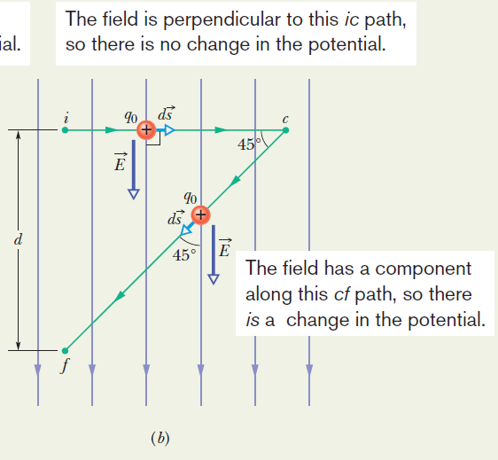
Example, Finding the Potential change from the Electric Field:

Slide 9
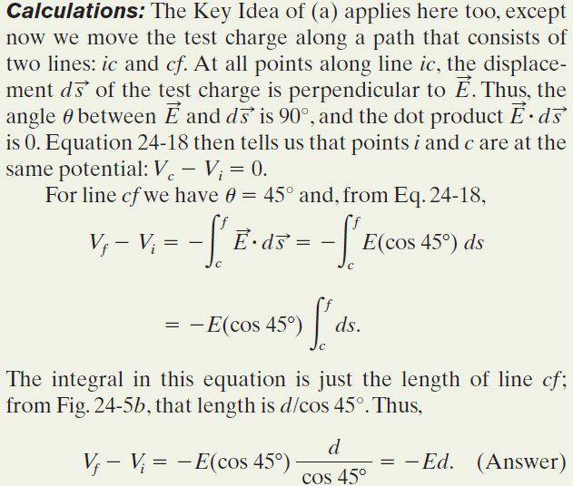
Example, Finding the Potential change from the Electric Field:

